Slide 1
Title – subtitle
Author
Event, date

Slide 2
Contents
Motivation
Topic
Summary
Sources

Slide 3
Motivation
<Motivation: Describe in a dotted list what is new and which problem is behind your academic work >
<For the whole presentation:
Avoid whole sentences whereever possible
Use figures, tables or diagrams whereever possible>
<Be careful with colors>
<Citation rules must be followed>

Slide 4
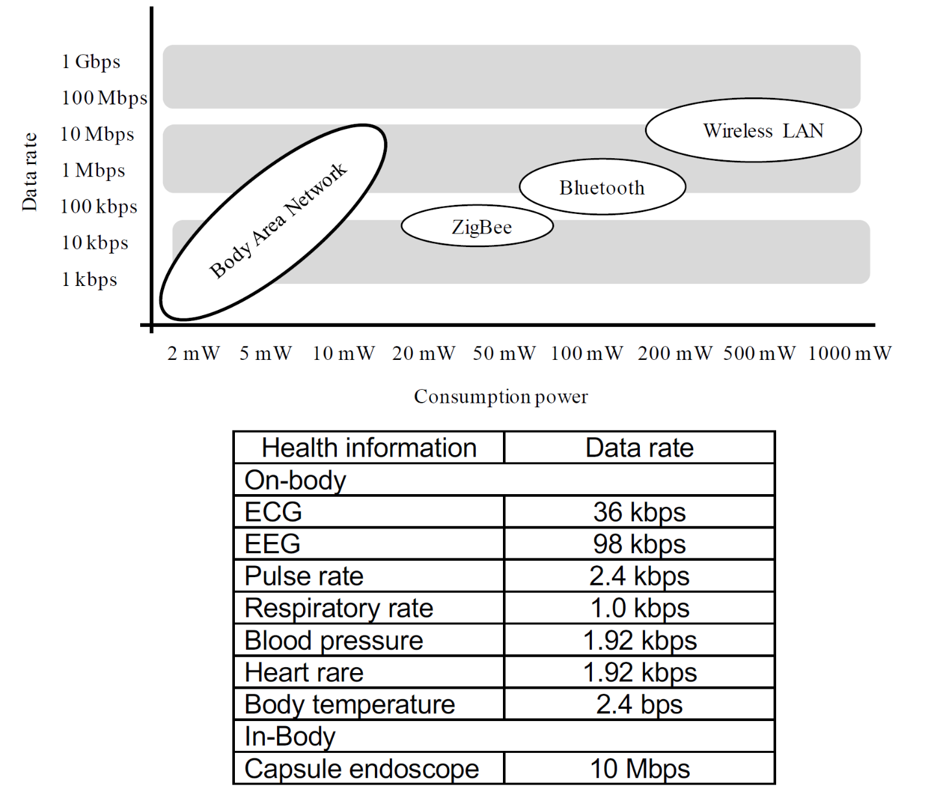
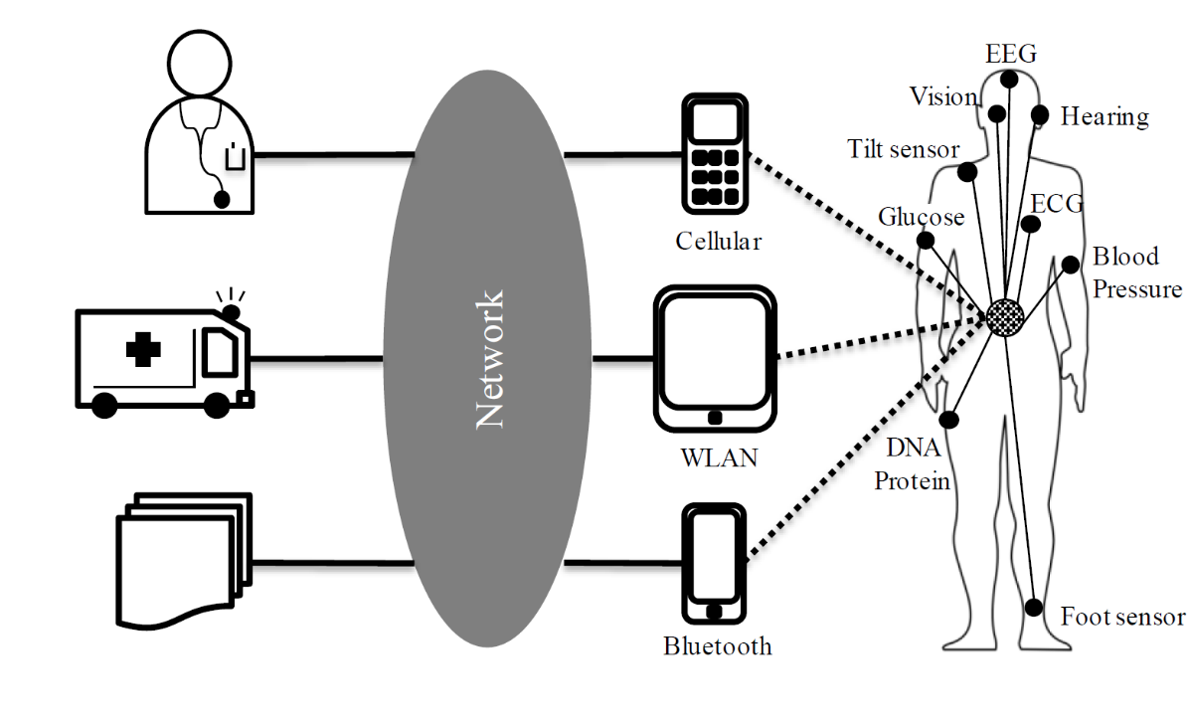
System Architecture
Describe the topic with overview diagrams and tables

Slide 5
Summary
Benefits/drawbacks
Next steps

Slide 6
Sources
Figures on page 3: lecture Body Area Networks, Prof. Dr. D. Anzei, Nagoya University, Japan, 2017

